Slide 1


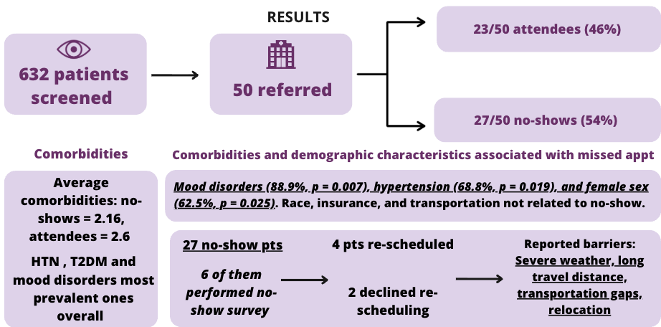
Why Patients Don’t Return: Comorbidities and Follow-Up at a Free Eye Clinic
James Whitley¹ BS, Valeria Villabona-Martinez¹ MD, Zeila Hobson¹ BS, Paula A Sepulveda-Beltran¹ MD, Brenda Kirk¹ COT, Jay Chhablani¹ MD, Evan Waxman¹ MD PhD
1. University of Pittsburgh Medical Center, Department of Ophthalmology, Pittsburgh, PA, 15219, USA.
Introduction and Purpose
Results
Patient no-shows are a challenge in healthcare, leading to reduced care continuity, increased system strain and stigma towards patients.
This study explores the impact of comorbidities, structural barriers and demographics on follow-up appointment adherence.
Understanding these factors can guide targeted interventions to improve patient retention and equity in eye care.
Methods
Conclusions
Future Endeavors
Surveys were administered at a free ophthalmology clinic.
For consenting patients, EMR records were reviewed for comorbidities across eight domains (Cardiovascular, Metabolic, Mental Health, Respiratory, Musculoskeletal, Neurologic, Cancer and Other) and follow-up.
Descriptive statistics and Fisher’s Exact/Chi-square tests were used for categorical variable analysis.
Follow-up was under 50%, revealing eye care continuity gaps.
Hypertension, mood disorders and female sex were linked to better follow-up adherence.
Structural barriers (transportation, weather, scheduling) limit follow-through.
Without tailored solutions, follow- through will remain a major gap in eye care, especially for male and healthier-appearing patients.
To explore effective strategies that meet patients where they are with mobile or community-based options.
Partner with Pitt CTSI to develop a multivariable logistic regression model of patient demographics and comorbidities predicting referral rate and follow-up adherence.
Use model insights to develop strategies that target clinics treating at-risk comorbidities to improve follow-up adherence.
References:
Schuldt, R.; Jinnett, K. Barriers Accessing Specialty Care in the United States: A Patient Perspective. BMC Health Serv Res 2024, 24 (1), 1549. https://doi.org/10.1186/s12913-024-11921-0.
Atta, S.; Zaheer, H. A.; Clinger, O.; Liu, P. J.; Waxman, E. L.; McGinnis-Thomas, D.; Sahel, J.-A.; Williams, A. M. Characteristics Associated with Barriers to Eye Care: A Cross-Sectional Survey at a Free Vision Screening Event. Ophthalmic Res 2023, 66 (1), 170–178. https://doi.org/10.1159/000526875.

